Slide 1

Slipstream Luggage
Market Review
Taking the Lug Out of Luggage Since 1976
Notes:
This file created specifically for Destiny Richardson

Slide 2

Industry Snapshot
Revenue
Annual Growth
Number Employed
Number of Businesses
$11 Billion
1.4%
76,000
28,000

Slide 3
Current Sales Environment
Steady Projections
34% Profit Margin
Retail & Online

Slide 4
Global Market
$48.4 Billion

Slide 5
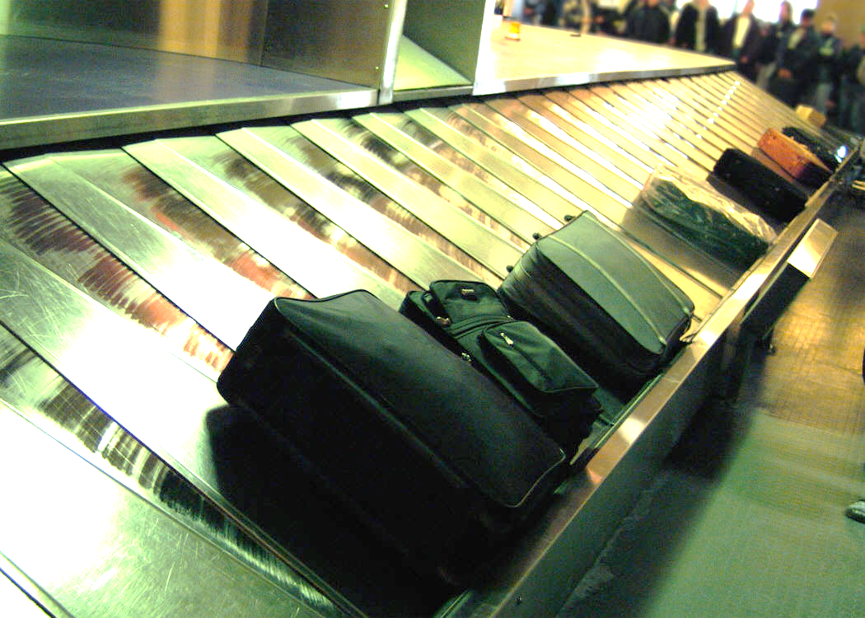
Luggage Requirements
Lightweight
Erginomic
Durable
Innovative
Quality

Slide 6
Best Sellers

Slide 7
Next Market: Generation Y
Most technologically savvy generation
Wants goods that express individuality
Responds to new take on promotions
Which means…

Slide 8
Generation Y
Purchases
$150 billion
per year
Influences additional $50 billion of Baby Boomer's family purchases
Likes department stores & online retailers

