Slide 1
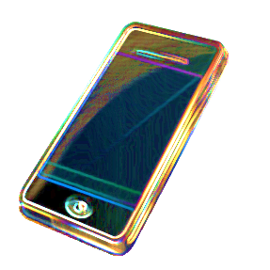
Ringtone App Analysis
APPS
MATTER
Notes:
This file created specifically for Destiny Richardson

Slide 2
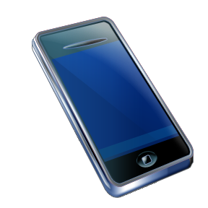
Personalized ringtones are easy to create
Evolution of the Revolution

Slide 3
Global ringtone sales history

Slide 4
Why People Choose a Ringtone
Public and personal soundtrack of their lives
Claim to identity and expression
Adds excitement or drama
Statement to others, reinforcement to self
Personal Branding = Big Business

Slide 5
What a “Bad” Ringtone Says About You
Not as funny as you think you are
Dull or pretentious
Immature or unprofessional
Unaware of surroundings

Slide 6
Apps Matter Ringtone Requirements
Ease of use
Select audio anywhere
Select exact start and end times
Select duration for ringtone and notifications
Notification length 3-5 seconds
Detect sounds in the environment
Regulate appropriate ring level – fainter or louder

Slide 7
Feature Comparison
Apps Matter | Diced Audio | Audio Chops
Any device | Apple | Any device
Free with ads | $3 | Free with ads
Ringtones, notifications, alarms | Ringtones, notifications, alarms | Ringtones, notifications, alarms
Up to 2 minutes | 40 seconds | 30 seconds
Top competitors

