Slide 1
Public Arts Projects
2016 Report
Columbia, South Carolina
Notes:
This file created specifically for Destiny Richardson

Slide 2
A Sense of Community Through Time
Arts Commission established in 1933
Jurisdiction over city’s public art collection
Public Arts Projects
Promotes diverse cultural environment
Integrates art into the experience of daily life
Encourages community participation
Preservation
Conservation of over 1,500 objects

Slide 3
Funding Sources
.05% for Art
Capital improvement funds
New buildings
Renovation
Civic infrastructure

Slide 4
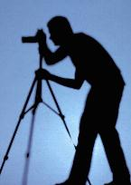
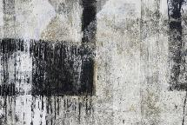
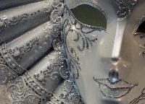
Art in the City

Slide 5
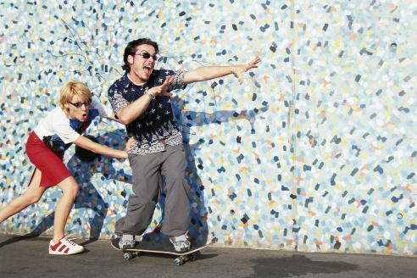
Participate!

Slide 6
2016 Projects
Murals
Bus shelters
Downtown
Decorative Bridge Railings
Freeway overpasses
Culverts and streams

Slide 7
New Award
YOUTH

